Slide 1

Midterm meeting
Road Grade-Aware Energy Consumption Modeling for EVs
○○ University of California, Berkeley,
○○ Mechanical Engineering,
Prof. Francesco Borrelli ○○○
August 2025

Slide 2
◆ List of researchers
Classification | Department | Name | Position | Email | Role
Research director | Dept. of Mechanical Engineering, UC Berkeley | Francesco Borrelli | Professor | fborrelli@berkeley.edu | Research Director, Head of MPC lab at UC Berkeley
Main researcher | Dept. of Mechanical Engineering, UC Berkeley | Mark Pustilnik | PhD Candidate | pkmark@berkeley.edu | PhD Student at the MPC lab
Researchers | Dept. of Mechanical Engineering, UC Berkeley | Yongkeun Choi | Post Doc. | yk90@berkeley.edu | Past Post Doc at the lab. Initiated the project

Slide 3
Contents
Background of the research | 4
Research goal and expected effect | 5
Research progress | 6
Research contents
1. Data Samples | 7
2. Data Filter and Normalization | 8
3. Data Analysis | 9-10
Midterm research results | 11
Future research plan | 12

Slide 4
Background of the research
Motivation:
EV range prediction is critical for adoption and user confidence (fight range anxiety).
Current models lack accuracy on hilly roads.
Problem Statement
Road grade has a significant impact on energy consumption
Most models are generic, not vehicle-specific
Identify the main parameters affecting the energy consumption of EV on sloped roads
Necessity
Develop and validate a physics/empirical model tailored for real vehicles on real roads
Incorporate an grade aware energy model in a car path planner

Slide 5
Research goal and expected effect
Research goal | Collect real world data of energy consumption, road grade and other relevant parameters Analyze and identify the main parameters that affect the energy consumption on roads with different grades Build and validate a road grade–aware energy model for electric vehicles
Expected effect | Improve the accuracy of trajectory planning with grade aware models lower the probability of energy distress of an EV due to higher than expected road grades

Slide 6
Research progress
Original plan
Current status
Item | Details | 1 | 2 | 3 | 4 | 5 | 6 | 7 | 8 | 9 | 10 | 11 | 12 | Remark
Basic study | Review MOST spec
 | Review equipment manual
Test bed establishment | Test new equipment
 | Develop MOST emulator
 | Develop emulator head and client
 | Integrated test and debugging
 | Develop test results analysis tool
Topology basic research | Literature investigation
Monitoring tool development | Develop program
 | Interlocking test and debugging
Final report | Wrap-up and submit a final report
▲ 1st technical meeting (Apr/2)
Delayed delivery of MOST equipment, purchase of related equipment
Equipment test delayed, malfunction of OASIS equipment
▲ 2nd technical meeting (Jul/15)
Delayed emulator development
Delayed equipment test
Delayed program development
▲ Interim meeting (Oct/30)

Slide 7
Research contents - Academic Papers
There are many academic papers that try to model the effects of sloped road on EV range performance
Most give a general model and not a vehicle specific (based on mass and road grade)
Some standout papers:
Oriol Travesset-Baro, Transport energy consumption in mountainous roads. A comparative case study for internal combustion engines and electric vehicles in Andorra (2015) – Talk about the difference between powertrain types on range performance on hilly road
Xiaodan Xu, A modal-based approach for estimating electric vehicle energy consumption in transportation networks (2019) - statistically-based energy model derived from simulator
Heran Shen, An Experimental Comparison of Physics-based and Machine-Learning-based Electric Vehicle Energy Consumption Estimation Methods (2023) – suggests that ML methods superior in accuracy but only on roads with enough data

Slide 8
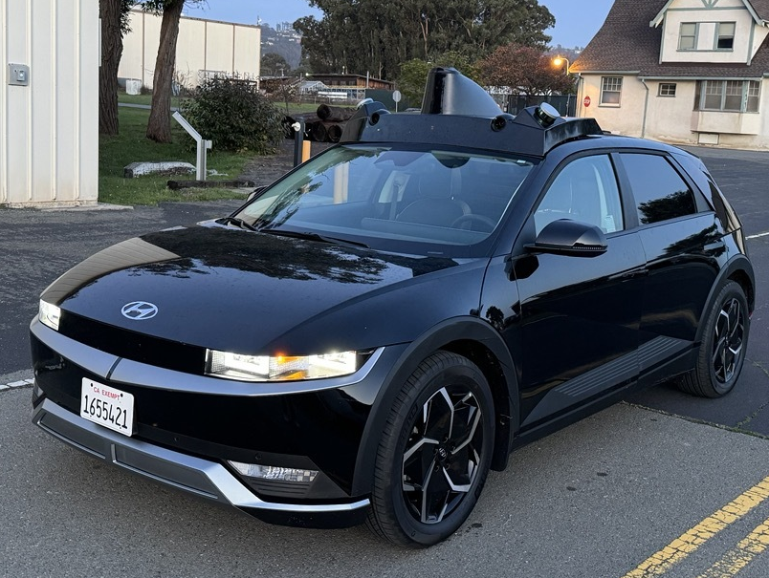
Research contents
Model: 2023 Hyundai IONIQ 5
Signals:
Vehicle
Speed, wheel torque, etc.
Energy
High/Low voltage battery power, SOC, etc.
IMU
Accel., pitch angles, etc.
GPS
Latitude, Longitude, and Altitude
(optional) Altitude through Google or HERE API

Slide 9
Research contents - Energy Usage Measurement
In this work, we measure energy consumption using the following high-voltage battery signals:
high-voltage battery current,
high-voltage battery voltage.
Additionally, we record auxiliary power usage (e.g., air conditioning and other onboard systems).

Slide 10
Research contents - Background: Factors Affecting EV Energy Consumption
Before discussing the impact of road grade on energy consumption, let’s consider the broader factors influencing a vehicle’s energy usage.
Road grade not only affects vehicle measurements, but vehicle behavior itself also plays a significant role in energy consumption.
From UC Berkeley’s previous studies on electric vehicle energy usage, higher driving speeds have been shown to lead to increased energy consumption.
Electric vehicles are less impacted by stop-and-go driving compared to internal combustion engine (ICE) vehicles.

Slide 11
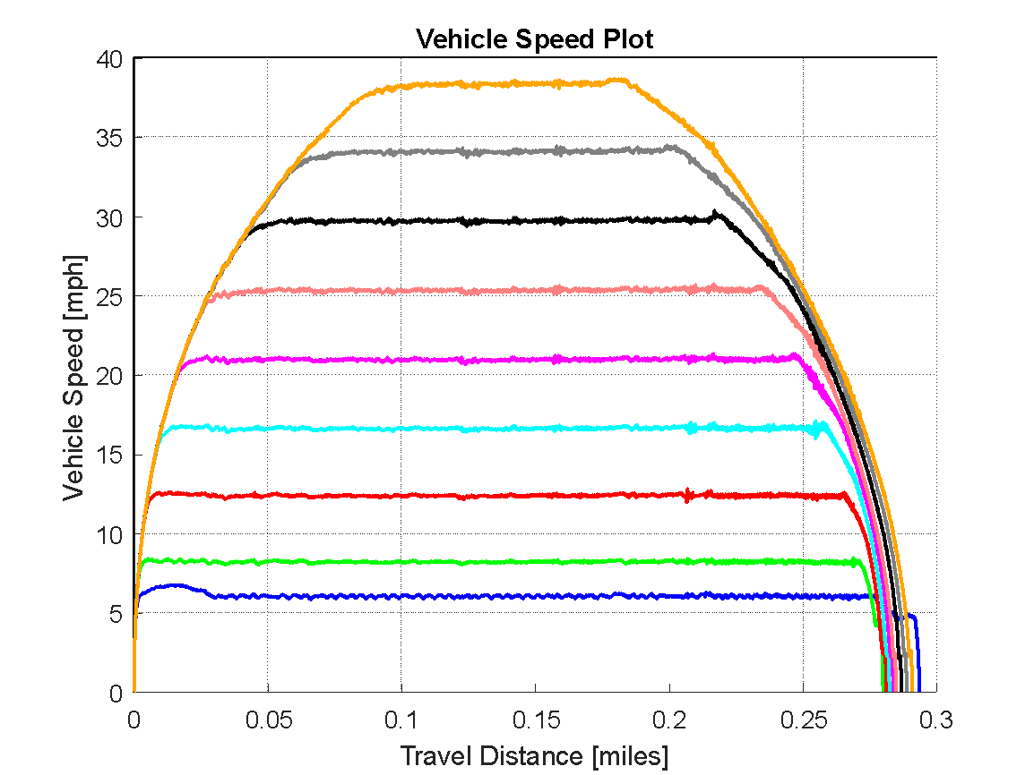
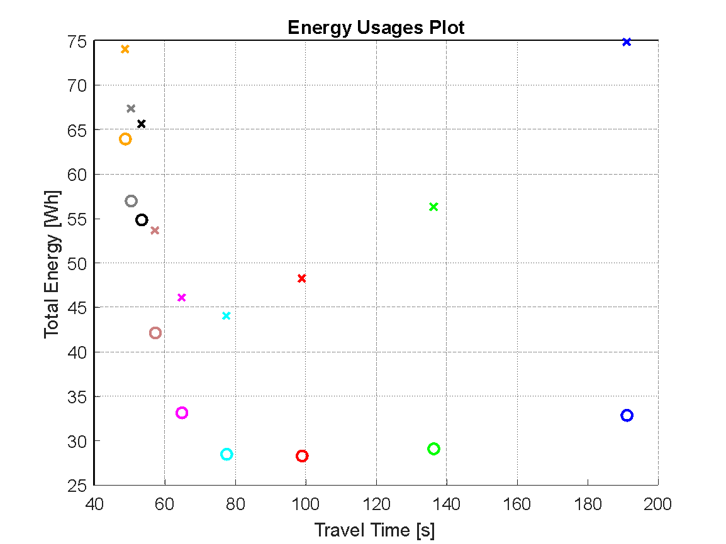


Research contents - Background: Factors Affecting EV Energy Consumption
The same color corresponds to the same run for the two figures above.
: High Voltage Battery Usage
: High Voltage Battery Usage – Auxiliary Power Usage (Motion Energy)

Slide 12
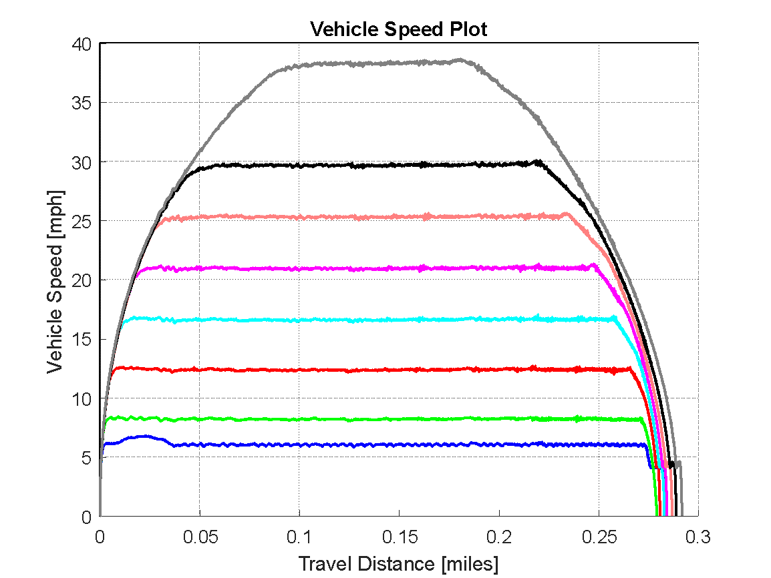
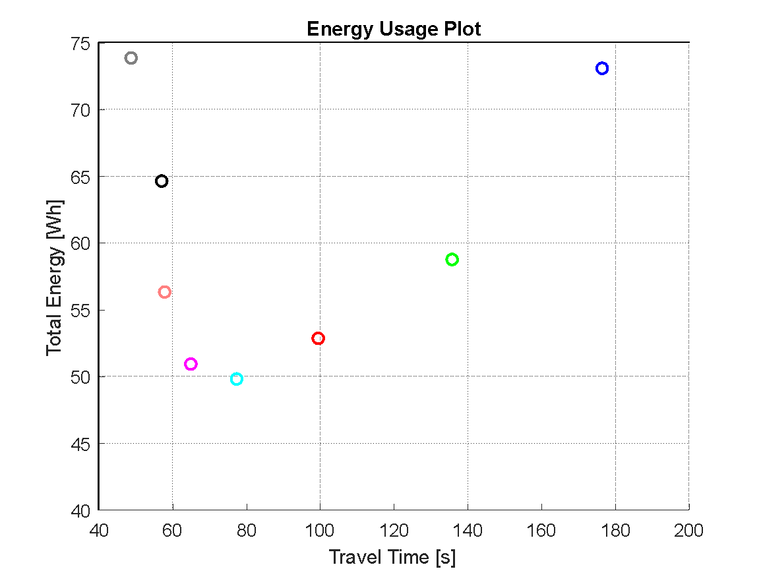
Research contents - Background: Factors Affecting EV Energy Consumption
The experiments were repeated with AC usage averaging approximately 440 watts.

Slide 13
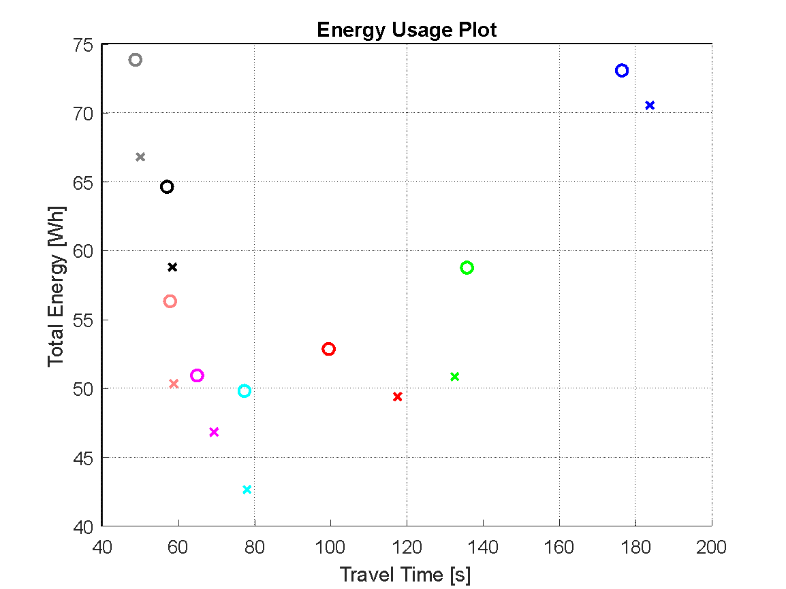
Research contents - Background: Factors Affecting EV Energy Consumption
O: With AC usage
X: Without AC usage
The experiments were repeated without AC usage. As a result, energy consumption decreased by 9.2% on average in experiments without AC usage.

Slide 14
Research contents - Background: Factors Affecting EV Energy Consumption
Based on this experiment, when comparing the impact of road grade on energy consumption, it is important to account for:
Auxiliary power usage (e.g., air conditioning)
Vehicle speed (travel time)
O: With AC usage
X: Without AC usage
The experiments were repeated without AC usage. As a result, energy consumption decreased by 9.2% on average in experiments without AC usage.

Slide 15
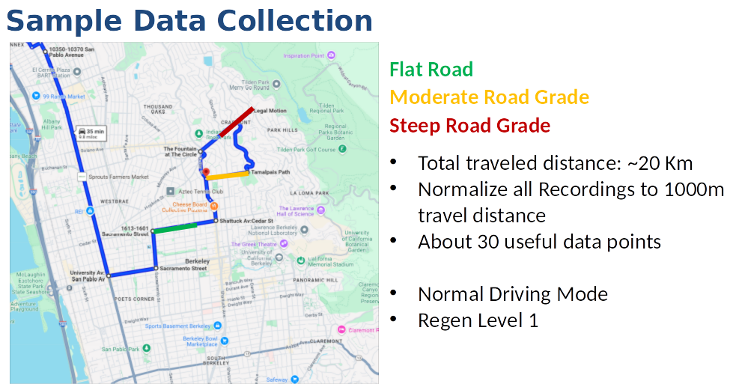
Research contents
Collected Data with full metry on a tailored drive in hilly Berkeley

Slide 16
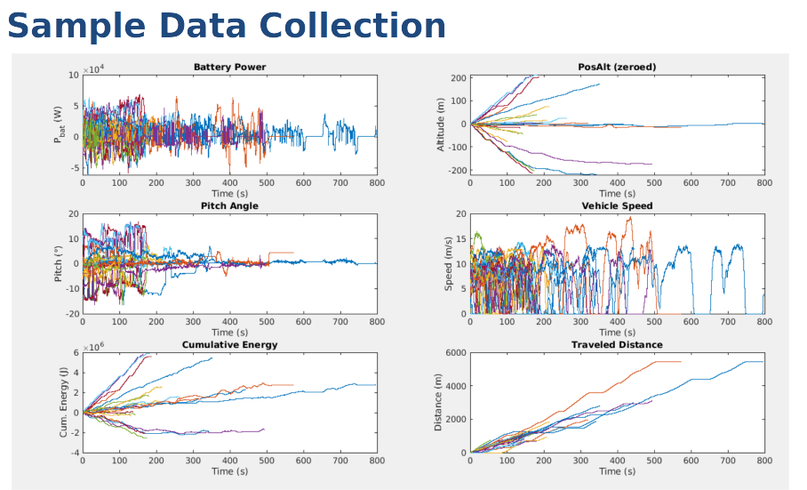
Research contents
Filter the data and normalize each valid data point to 1000m

Slide 17
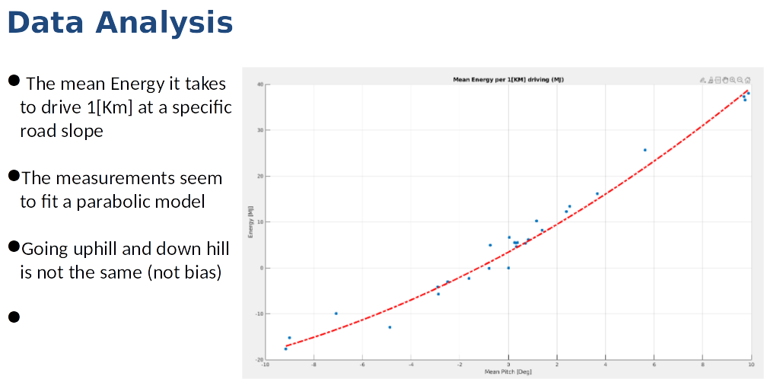
Research contents
Identify the main parameters that affect energy consumption and suggest a prediction model

Slide 18
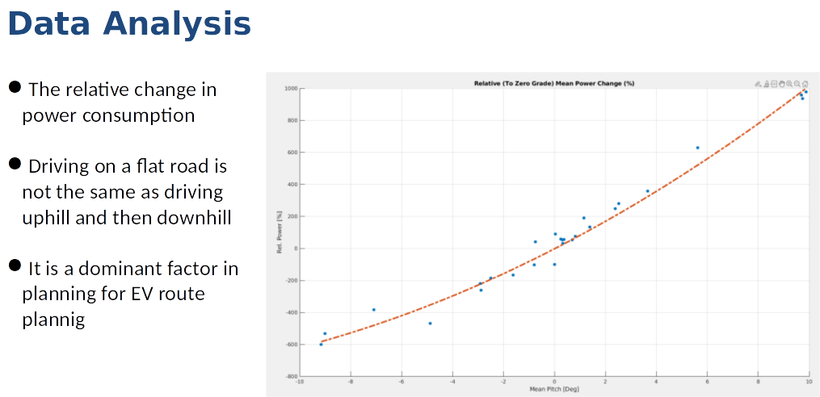
Research contents
Data analysis - The effect of sloped roads on EV energy consumption is dramatic and should be taken into account, can increase power consumption by hundreds of presents

Slide 19
Midterm research results
Research results | Characteristics/Performance | Remark
Mid-term report | Collected data on a Hyundai IONIQ 5 for many driving scenarios on different road grades Analyzed the data and suggested a model that can fit the data identify weak points of the model
Final Report
H/W
S/W | Implement a model that predicts the energy consumption based on road grade and other driving parameters Develop analysis tool to generate a model to predict energy consumption of EV on sloped roads Implement a path planner that can take into account energy consumption based on road grade
Theses |  | □ submission □ Published □ Expected date (00.00.00)
Patent |  | □ Application □ Registration □ Expected date (00.00.00)

Slide 20
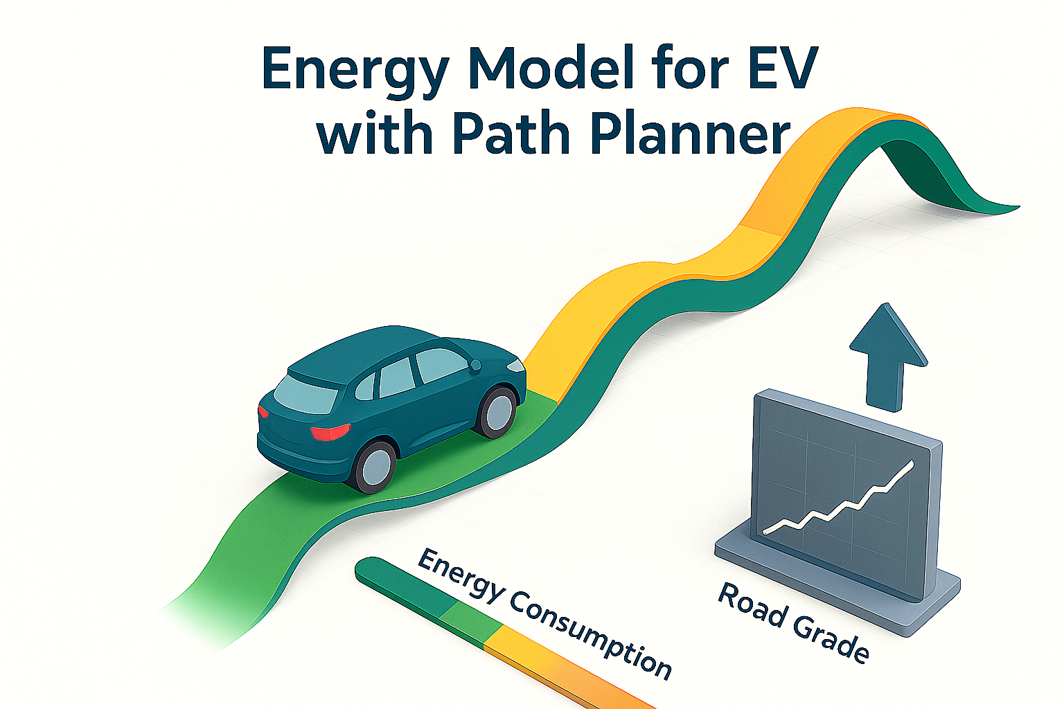
Future research plan
Next steps
Collect more data on different ReGen levels to see the effect on energy consumption
Generalize a energy consumption model not specific for a single car
Incorporate the energy model suggested in a path planner to see the effect
Research Goal:
Develop a grade-aware energy prediction model that is about 25% accurate in validation scenarios

